Slide 1

Learning and Prediction over Massive Spatio-temporal Data
Dong Wang
Institute for Interdisciplinary Information Sciences
Tsinghua University, China

Slide 2

My Profile
Research Interests
Deep Learning, Machine Learning, Spatio-temporal data mining
Awards
Rank 2 / 1648, Didi Supply-Demand Challenge Competition 2016
The Most Potential Prize, Didi Supply-Demand Challenge Competition 2016
Rank 3 / 1956, Datacastle Travel time estimation competition 2017
Publications
A-level conferences: IJCAI 2017 (submitted), ICDE 2017, ICDE 2016, Ubicomp 2016
B-level conference: DASFAA 2016
Notes:
Generally speaking, the spatio-temporal data is the data which contains the spatial and temporal attributes.
To make it more concrete, we show several example.
The first one is the gps data which contains the location and time information. The gps data is widely used in navigation, traffic management and so on.
The spatio-temporal data is also generated in the warehouse management when delivering the goods from the suppliers to customers.

Slide 3
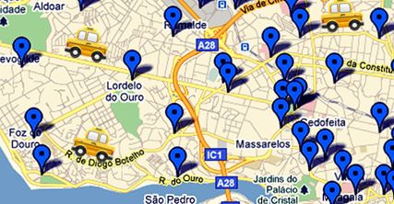
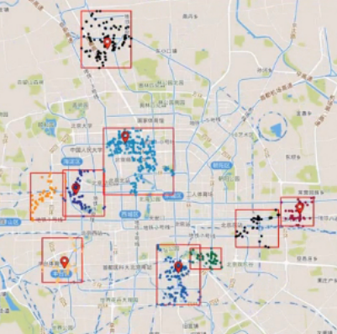
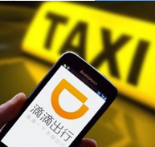
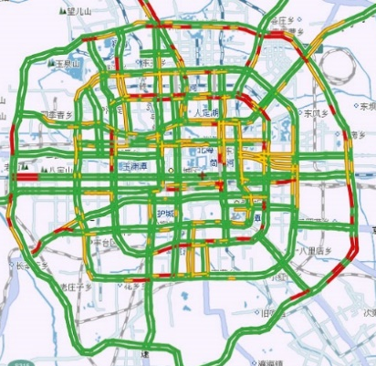
Spatial Temporal data
Traffic
Economy
Location and time information
Navigation, traffic management etc.
- Store Site Selection
Notes:
首先我们讲一下什么是时空数据。简单来说，时空数据就是同时带有时间和空间两种属性的数据，比如gps数据，其中包含了经纬度，时间戳。但是时空数据包含的范围远远不止gps一种，实际上时空数据在生活中被应用到方方面面。举几个具体的例子，交通领域我们用用户定位数据数据来分析一段时间人流的动向，用在线叫车数据预测城市不同区域打车的供需。在经济领域，我们用不同地区用户对某些商品的搜索数据来做商业选址。

Slide 4
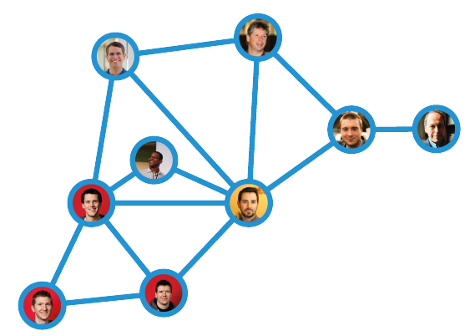


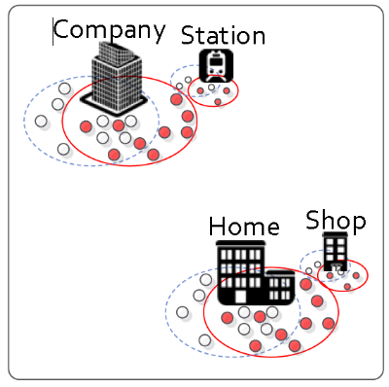

Spatial Temporal data
Social
Warehouse management
Check-in data
Infer or recommend the friend to users
Pick requests
Delivering data
Notes:
在社交领域，我们利用用户在各地的签到数据构建社交关系网进行推荐。在仓储管理上，我们用商品出库入库时间数据预测商品一段时间的提货量从而进行仓储摆放的优化。等等等等。我刚所说的这些还只是时空数据应用的冰山一角，可以说他和诸多领域都有所连接并成为了近年的一个热点研究方向。

Slide 5
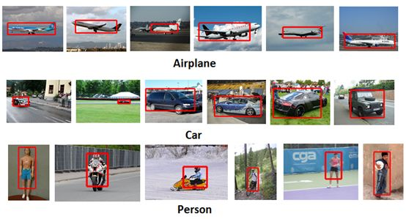

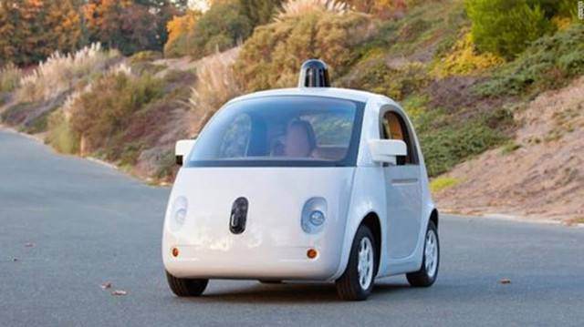


Deep Learning
The hottest topic in ML / DM
Standard Architecture
Images/Videos —— CNN
Text/Speech —— RNN
Playing Games/Auto Drive —— DQN
No standard architecture for spatio-temporal data.

Slide 6
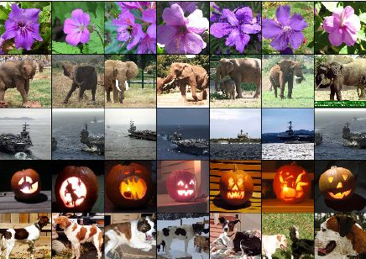

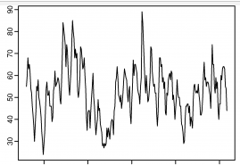
Characteristic
Spatial dependence
different locations interact on each other
compare with images:
city level scale, sensitive to the granularity
Temporal dependence
past states affect the future
compare with texts/speech:
periodicity in multi-granularity
highly affected by sudden event (raining, traffic accident)
Notes:
For example, the traffic congestion on one road, may lead to the congestion on its adjacent roads.
Image也有spatial dependence，there are also co-relations between different pixels。
However, 相比于images，st data 通常Large scale， city level scale 甚至larger，
Coarsen image you can still identity the object in the image，而spdata中coarsen会导致严重info loss。
Similar characteristic also appears in speech and texts. However, compare with text and speech, sp
data usually have strong preriodicity in muti-granularity, such as day, week, season, or year
Another difference, extreme weather,
You know 下雨天难打车，it always takes much longer time to wait for a taxi than usual。

Slide 7





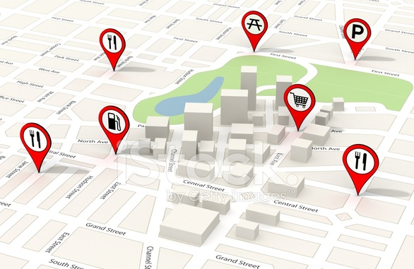
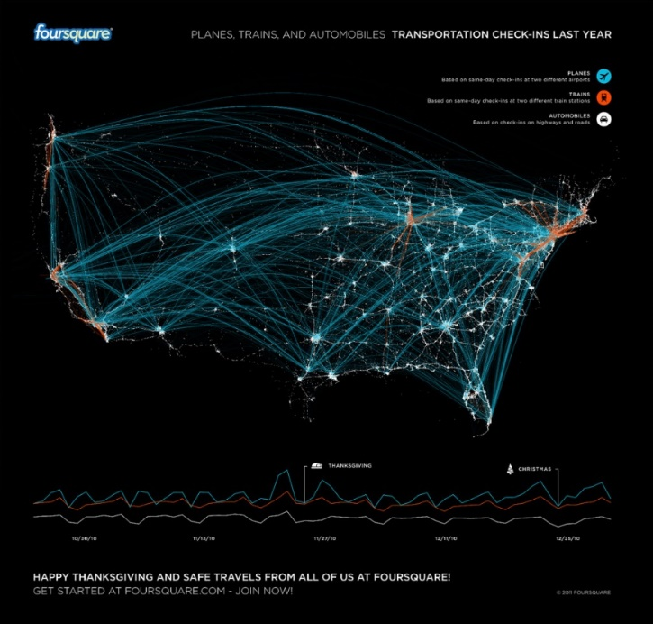

Characteristic
Diverse data sources
Mobile phones, online car-hailing orders, weather, POIs, etc.
Massive, highly noisy
Notes:
The third
Collected from diverse data sourse。Gps divaises, online car hiring orders,
The last, but not the least one.
To deal with such massive data, We need the help of big data platform, such as Hadoop and spark.

Slide 8
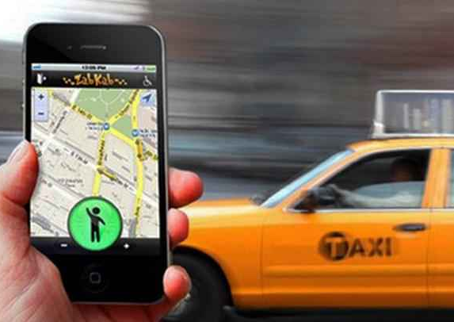
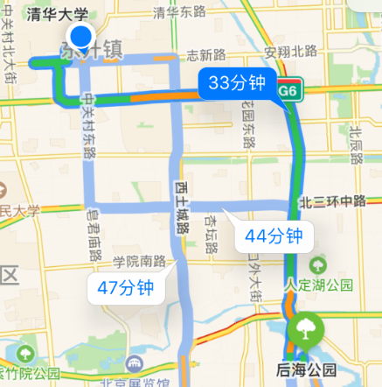
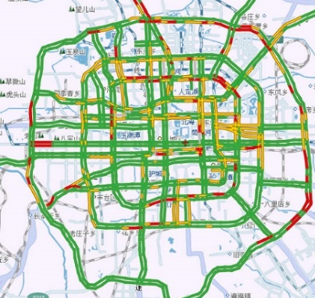
PhD Work
Social relationship detection
- Automatic User Identification across Heterogeneous Data Sources
Traffic condition Prediction
- Traffic Condition Prediction System
Supply-demand Prediction
- Online Car-hailing Services
When will you arrive?
- Estimating Travel Time Based on Recurrent Neural Networks
Notes:
时空数据在交通上有很多有趣的应有，我们做了4个work，分别是：
We collect user trajectories from different data source, however, we don’t have the user id. Our work is to identify which trajectories belong to the same user.
We present a traffic condition prediction system, which can…
今天重点讲下前两个work，后面两个也会捎带提一下。

Slide 9

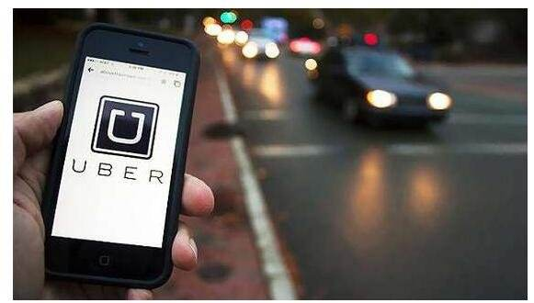
Supply-Demand Prediction for Online Car-hailing Services using Deep Neural Network
Objective
Predict the gap between the car-hailing supply and demand in a certain area in the next 10 minutes.¹
This problem is from Di-tech Algorithm Competition 2016
Motivation
Balance the supply-demand by scheduling the drivers in advance
Adjust the price dynamically
ICDE 2017
Notes:
we study the problem of predicting the real-time car-hailing supply-demand, which is one of the most important component of an effective scheduling system.
Our objective is to predict the gap between the car-hailing supply and demand in a certain area in the next few minutes.
Based on the prediction:
1 minimize the waiting time of passengers, and maximize the driver utilization.
2 …you know the supply demand always determine the price
3. If we know .. In advance, we can recommend the driver in which areas they can pick-up passenges easily. Increase the income of drivers

Slide 10
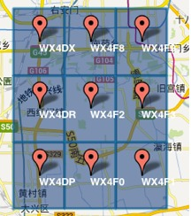
Definitions
Car-hailing order valid (invalid)
Date 2. Timeslot 3. Passenger ID
4. Star area ID 5. Destination area ID
Environment data:
1. weather 2. traffic condition
Objective
Predict the supply-demand gap (e.g., the number of invalid orders) of a certain area, in the next 10 minutes.

Slide 11
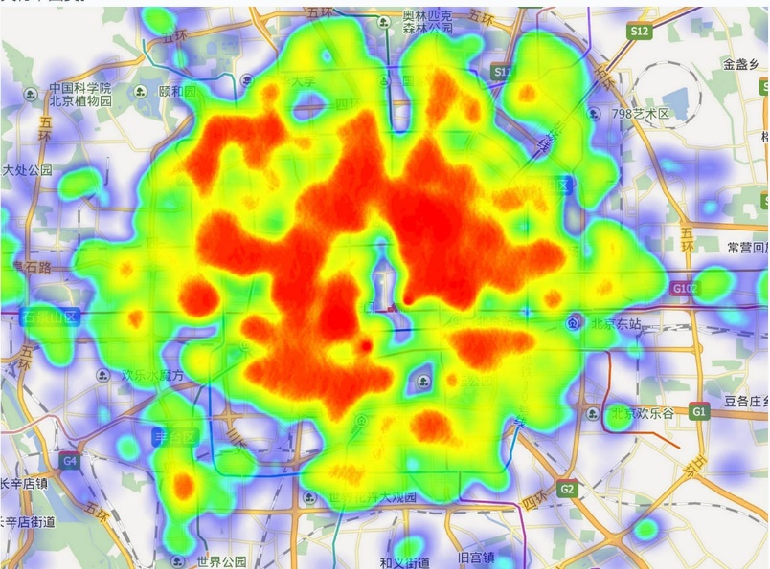
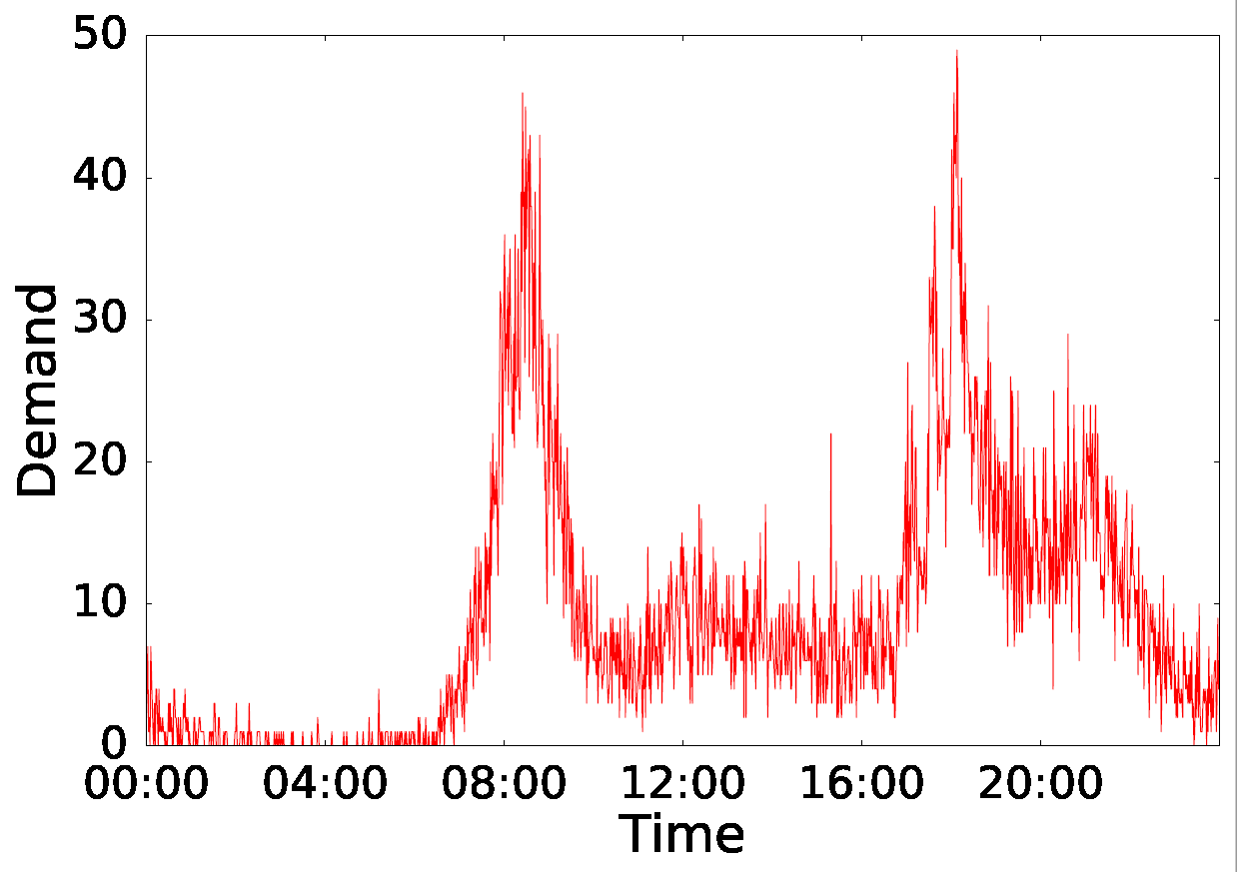
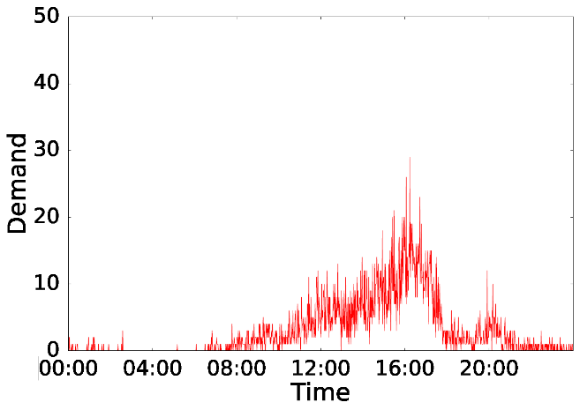
Challenges
The car-hailing supply-demand varies dynamically
geographic locations
time intervals.
Standard models +“hand-crafted” features
Logistic regression, SVM, random forest, gradient boosting
Various data types
Order, date, weather, traffic
Various data sources
Notes:
To motivate our approach, we first present some challenges of this problem, and discuss the drawback of current standard practice for such proble.
1. The car-hailing supply-demand varies dynamically due to different geographic locations and time intervals.
For example, morning demand tends to surge in residential areas, whereas evening business areas. Supply demand patterns under different days of week can be extremly different
build several sub-models for difffenrt locations and time.
tedious and lack of training data
2
timestamp, start location, destination, etc.
Non-trival to use them in an unified model.
“hand-crafted” features
off-the-shelf learning algorithms lr rf.

Slide 12
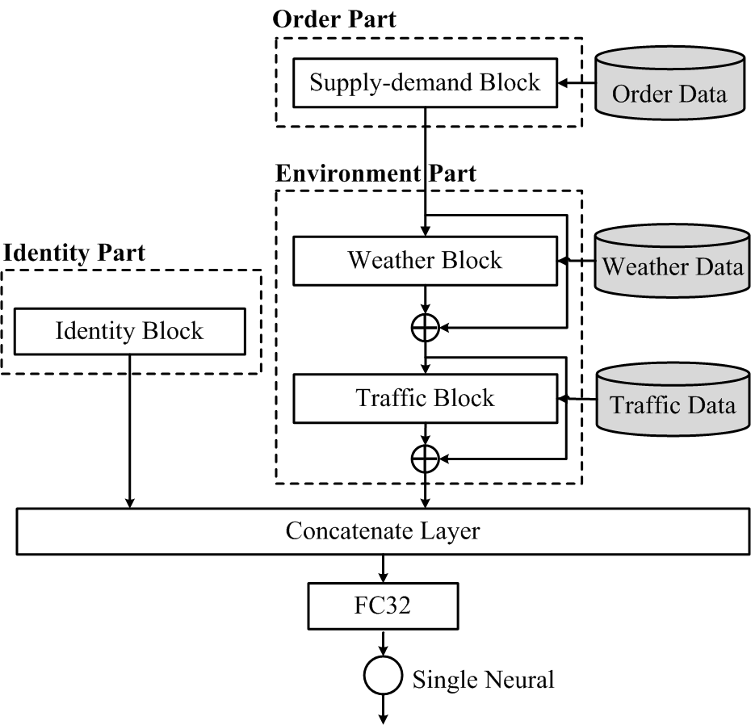
Framework
General blocks
Using embedding to “cluster” similar areas and timeslots
Learning the useful feature vector from the order data
Connecting different blocks with residual link
End-to-end model
Notes:
Framework
End to end, three main part
First embed
Order most import ..
Affected by Environment data, involving them to adjust the previous learnt features by residual…
Come to the detail of each part.

Slide 13
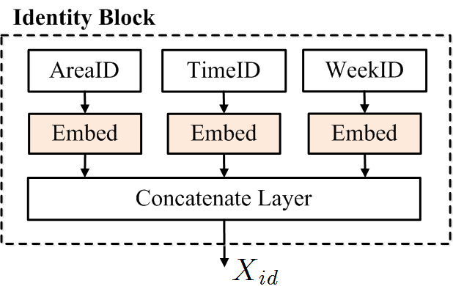
Identity Part
Different areas at different time can share similar supply-demand patterns.
Prior work clusters the similar data :
Manually design the distance
measure
Build several sub-models
(business area, residential area, etc.)
这里说明图片内
Notes:
不同区域不同时间的supply demand gap 可以share similar pattern， eg. heavy for all the areas around the business center at 19:00.
强调一下：
这是个通用模块，可以帮助发现、聚合一些相似的地理区域，或者时间片和星期。
并且这个模块中可以方便的添加一些其他特征，比如说：？？？区域用电问题，区域，季节，民用电还是生产用电？

Slide 14
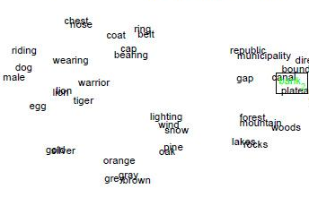
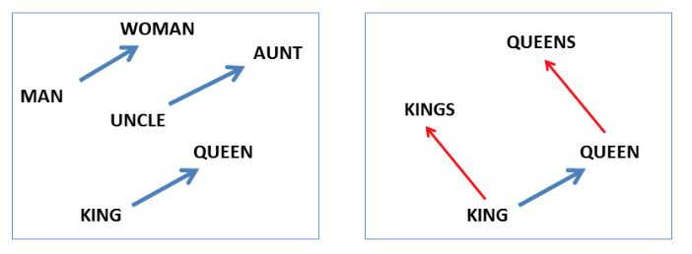
Embedding
Categorical value -> real vector
Discover semantic similarity
这里说明图片内
Notes:
不同区域不同时间的supply demand gap 可以share similar pattern， eg. heavy for all the areas around the business center at 19:00.
强调一下：
这是个通用模块，可以帮助发现、聚合一些相似的地理区域，或者时间片和星期。
并且这个模块中可以方便的添加一些其他特征，比如说：？？？区域用电问题，区域，季节，民用电还是生产用电？

Slide 15
Effects of Embedding
Notes:
放前面

Slide 16
Order Part
How is the usually like on historical Mondays?
Notes:
在实际案例中，我们发现不同星期天他们的订单供需模式可能是非常不同的，比如有些地方周一到周二都是上下班高峰有个很大的供需缺口，而周五周六周日的供需缺口一天分布的都比较均匀也比较小，而另一些地方可能就又不一样。
那么之前有的工作的做法是，我把周一的数据单拿出来训练一个模型，然后周二的数据再单训练一个模型，
这样非常tedious，而且不同模型间数据不能共享，使得数据利用不充分；
我们的做法是：把所有数据拿出来一起训练，但是给他们每天一个不同的权重，这个权重由我的网络自己学习。
对于周一到周日统计一下均值，对areaid和weekid进行embedding，学出来一个权值向量，用这个向量来对历史均值进行加权求和，我们的实验也非常明显的证明了这个设计的功效。
要不要说一下这个weighted sum layer是我们自己定义的？

Slide 17
Effects of Embedding
Area 1
Area 26
We visualize the weight vectors in two different areas at Tuesday and Sunday.
Notes:
We visualize the weight vectors in two different areas at different day of week.
The blue bar .. The red bar ..
weight vectors Extremely different .
However, same day of week, the weight vectors of different areas different.
Significatly high than other, uniform

Slide 18
Residual links
Weather Block
Residual link
Take the output of weather block as the “residual”
Makes the model more flexible to incorporate new data
Notes:
具体并不用讲，重点突出residual
Order part输出的结果相当于我的x，我将order part 从历史订单信息中学出来的feature vector与我从天气数据中学出来的feature vector共同经过2层全连接网络，得到一个新的feature vector，这个就对应之前的f（x）, 之后将这个加和向后传播。
这样我们可以将weather的信息用来修正预测。（举例？专家那个？合适讲吗？）
通过residual来进行连接的是个好处： 1、稳定训练，得到更好的结果， 2. 使得模型更flexible，方便随时加入新的外部数据（实际应用中很常见），甚至不需重新训练，只需要在原有基础上继续refine，节省时间
Traffic修正，
Poi可能也会有影响

Slide 19
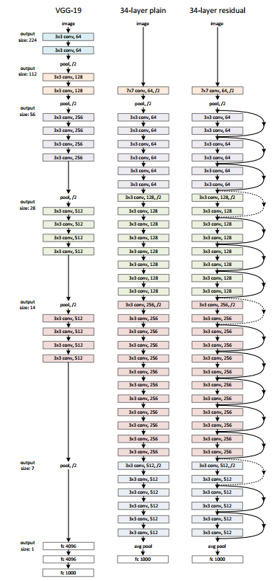
Deep Residual Networks¹
Train very deep neural network
- Gradient vanishing/exploding problem
Add connections between layers
[1] He, Kaiming, et al. "Deep residual learning for image recognition." Proceedings of the IEEE Conference on Computer Vision and Pattern Recognition. 2016.
Notes:
主要用在cv领域，可以train很深的网络
Many non-trivial tasks have greatly benefited from very deep neural networks, which reveals that network depth is of crucial importance.
However, an obstacle to train a very deep model is the gradient vanishing/exploding problem, i.e., the gradient vanishes or explodes after passing through several layers during the backpropagation \cite{schmidhuber2015deep,lecun2015deep}.
To overcome such issue in deep neural networks, He et al. \cite{He2015Deep} proposed a new network architecture called the residual network (ResNet), which allows one to train very deep convolutional neural networks successfully.
The residual learning adds the shortcut connections (dashed line) and direct connections (solid line) between different layers.
In the residual network, instead of learning the mapping function H(x) directly, we learn the residual mapping f(x)= H(x) - x and broadcast F(x) + x to the following layers.
It has been shown that optimizing the residual mapping is much easier than optimizing the original mapping \cite{He2015Deep}, which is the key to the success of deep residual network.

Slide 20
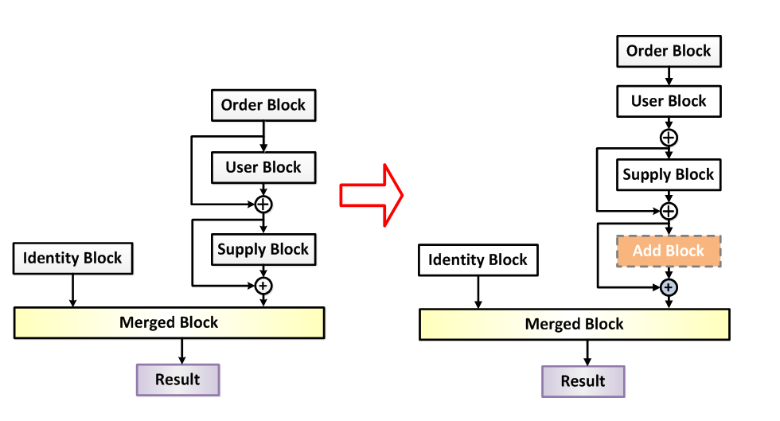
Incorporate New Data
Makes the model more flexible to incorporate new data
Notes:
随时加新数据，放入新block中作为残差放入原有网络。
重点是不用重新train了，新加入的block不影响我之前的结构，我可以之前学好的版本上refine就可以，节省时间，发现效果不好也可以随时删掉

Slide 21
Experiment
Table: Performance Comparison
Model | Error Metrics
 | MAE | RMSE
Average | 14.58 | 52.94
LASSO | 3.82 | 16.29
GBDT | 3.72 | 15.88
RF | 3.92 | 17.18
Basic DeepSD | 3.56 | 15.57
Advanced DeepSD | 3.30 | 13.99
Notes:
1
build several sub-models
tedious and lack of training data
2
timestamp, start location, destination, traffic condition, weather condition etc.
“hand-crafted” features
off-the-shelf learning algorithms

Slide 22
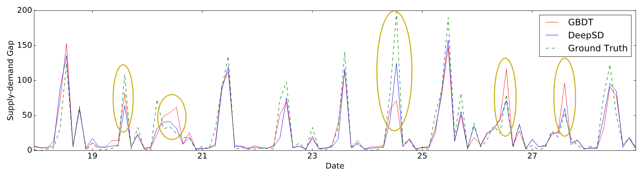
Experiment
Notes:
1
build several sub-models
tedious and lack of training data
2
timestamp, start location, destination, traffic condition, weather condition etc.
“hand-crafted” features
off-the-shelf learning algorithms

Slide 23
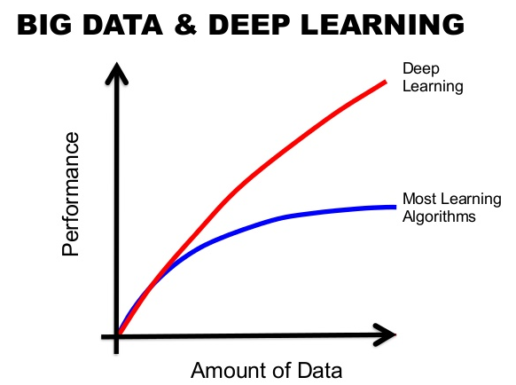
Conclusion
End-to-end model
Design a general block
Learn the useful feature vector from the order data
Involve in new external data easily
Great potential
Notes:
讲一下模型优势：
End to end模型，方便使用（比赛中多是不同模型叠加，降低variance的方式提高结果），单模型，几乎没有手提feature的情况下，我们的模型可以取得一个competitive的结果
设计了一个通用的block： identity block，可以利用word embedding自动发现相似的格子，使得这些格子能够共享数据，避免了传统手工设计距离、分开建模的问题，而且后面我们模型中也还在使用，效果好
自定义了一个weighted sum layer，显示的促使网络去自行学习对不同星期的依赖，（比较过往）数据利用率高，
通过residual的方式连接不同block，不仅使得训练过程更稳定，结果更好，也是的模型更flexible。方便引入新的外部数据，我们的模型对一种数据设计一个block，新来数据放入新的block，通过residual放进来，不用重新训练，直接refine，非常灵活
比赛中只有一个月数据，实际中数据肯定比这个多很多，模型还有很大潜力

Slide 24
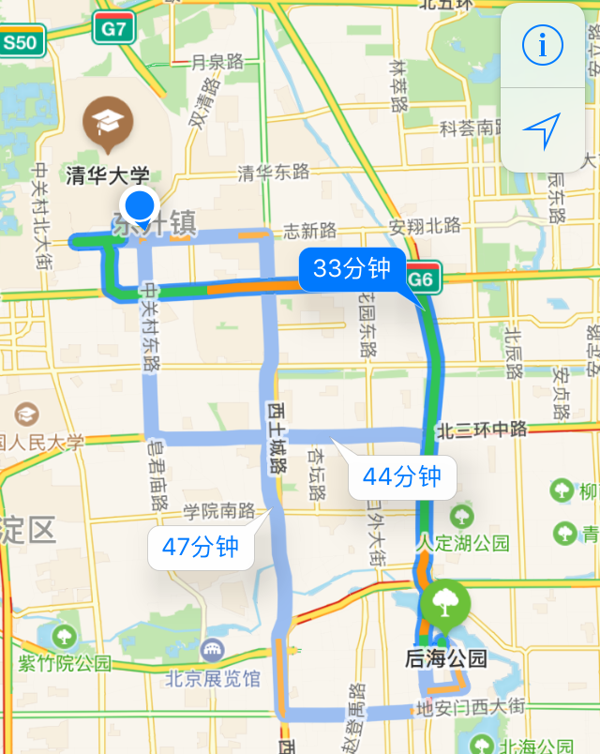
Estimating Travel Time Based on Recurrent Neural Networks
When will you arrive?¹
Motivation
Routes planning, Navigation
Traffic dispatching
Previous work
Estimate for each individual road
Road intersections and traffic lights
No driving habits
1. This problem is from DataCastle 2017
IJCAI 2017
Notes:
An accurate estimation of travel time helps people better planning their routes
electronic maps and online car-hailing services provide the TTE in their apps, such as Google Map, Uber, Didi, etc.
放手机预测时间截图
过往预测方法有哪些不好的地方

Slide 25
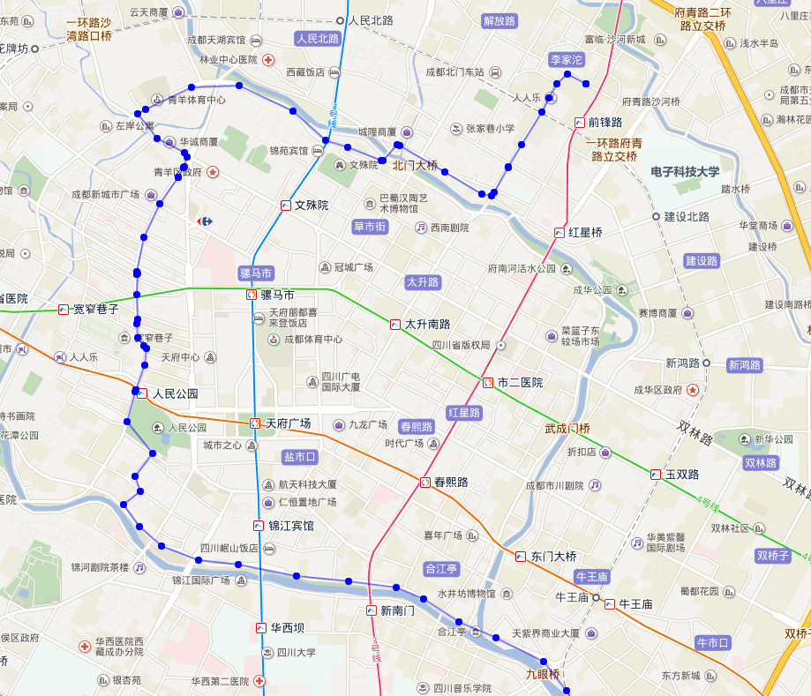
Definitions
Objective
Given: 1. path 2. driver 3. start time
Estimate:
the travel time for the given path.
Train data
GPS trajectory
Sample points from path
Notes:
加图
[Historical Trajectory]
We define a historical trajectory T as a sequence of consecutive historical GPS points, i.e., $T = \{p_1, \ldots, p_{|T|}\}$. Each GPS point $p_i$ contains: the latitude (p_i.lat), longitude (p_i.lng) and the timestamp (p_i.ts). Furthermore, for each trajectory we record its corresponding driver ID which we denote as driverID.
%During the training phase, we learn how to estimate the travel time of the given path, based on the historical trajectories.
%To make the testing data consistent with the training data, we convert the path $S$ to a sequence of location points by sampling. Each location is represented as a pair of longitude and latitude.

Slide 26
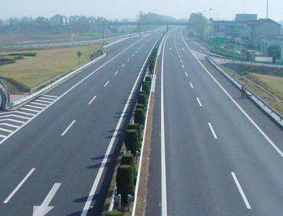
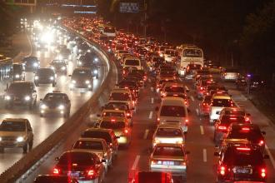
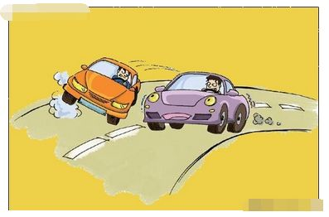
Challenges
The travel time of a specific path can be very different
Peak/Non-peak hour
The day of the week
Diverse values of trajectory length/distance.
Different driving habits
Notes:
郑宇那个work比较（如果问起来的话）
第一个：作为一个整体来进行建模预测，
之前的1 大多都是分路段或者是分sub-trojectory，拐弯和红绿灯不能整体建模 （郑宇的也是在一定程度上缓解了这个问题）
有部分是整体的，但是是直接选定热门path，只能预测小部分的，历史上没人在特定时间走过就没办法预测

Slide 27
Architecture
Use Attributes Component incorporate various factors
Use Sequence Learning Component to handle trajectory
Use Estimation Component to predict the travel time
Extend to multi-task learning by introducing an Auxiliary Component
这里说明图片内
Notes:
亮点讲一下,xu check

Slide 28
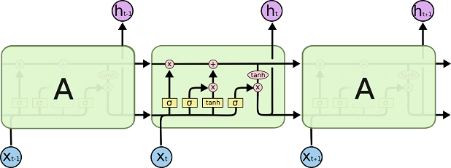
Sequence Learning Component
RNN(Recurrent Neural Network)
LSTM (Long Short Term Memory)
Time dependence and spatial dependence
Notes:
考虑到轨迹中包含时间和空间双重相关，而rnn在speech，nlp等序列处理上有较好的表现，所以我们考虑尝试用rnn来model我们的轨迹。
而后，考虑到轨迹长度,lstm
首层LSTM的输出序列{h}作为下一层LSTM的输入
更够更好捕捉数据中的时间依赖性

Slide 29
Sequence Learning Component
x_{i} -> h_{i}
Abstract of the first i points
Deal the new point
Trajectory -> Vector
Represent the whole trajectory with all h_{i}.
Handling different trajectory lengths
Mean Pooling Trick
Sampling Trick
这里说明图片内
Notes:
重点突出不同每个轨迹点对应一个hi
前i个点构成轨迹的“抽象向量表示”:
轨迹长度，位置，路径形状等等
处理新的轨迹点时结合当前点和前面整段轨迹
整合所有hi：用一个高维向量表示整段轨迹信息

Slide 30
Auxiliary Component
To utilize the “local information”
estimate the travel time of each sub-trajectory
extend to a multi-task model
used as the auxiliary output
Sub-trajectory
Notes:
神经网络不好train， rnn/lstm更不好train（为啥？）
然后我们发现还有些信息没有用，…
但是我们发现，直接用这个的加和作为预测结果，效果并不好。
However, the residual component only considers the “global information” of the whole trajectory but ignores the travel time of sub-trajectories which we refer to as the “local information”.
Instead of using the summation as the estimation, we design a muti-task neural network.
This part is trained together with other components.

Slide 31
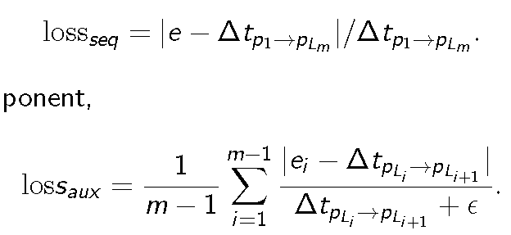
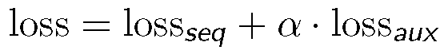
Model Training
Evaluate: mean absolute percentage error (MAPE)
Estimation Component
Auxiliary Component
Final loss:
这里说明图片内
Notes:
强调一下这是比赛中衡量标准，我们直接延续过来使用。
然后介绍一下mape是啥

Slide 32


Experiment
Data Description
1.4 billion GPS records of 14,864 taxis in Oct. 2014 in Chengdu.
Total number of trajectories: 9,653,822. (60GB)
Use the last 7 days (from 24th to 30th) as the test set and the remaining ones as the training set.
Notes:
一定要突出数据量大，有多少G！
以前的work有多少！

Slide 33
Experiment
Table: Performance Comparison
Model | MAPE
Gradient Boosting | 20.32%
MLP-3 layers | 16.17%
MLP-5 layers | 15.75%
Vanilla RNN | 18.85%
DeepTTE | 13.14%
Notes:
强调一下，我们为了公平起见，对于所有model采样相同的feature，由于数据量过大，过高维度的feature，单机开源的gdbt跑不起来
和rnn处理过长序列的不稳定，采用了sample30个点的版本。这个不是我们的最好结果。

Slide 34
Experiment
Table: Performance of Different Number of Samples
#Samples | MAPE | Time (per epoch)
DeepTTE-10 | 15.45% | 674s
DeepTTE-30 | 13.14% | 1729s
DeepTTE-70 | 13.02% | 3879s
DeepTTE-100 | 12.74% | 5484s
DeepTTE-Var | 12.87% | 5841s

Slide 35
Experiment
Effects of Components
Eliminate Estimation Component, 28.44%;
Eliminate Auxiliary Component, 13.95%;
Our entire model, 13.14%.

Slide 36
Experiment
Table: Effects of Attribute Component
Model | MAPE
DeepTTE-30 | 13.14%
Eliminate driverID | 13.37%
Eliminate weekID | 13.58%
Eliminate both | 13.59%

Slide 37
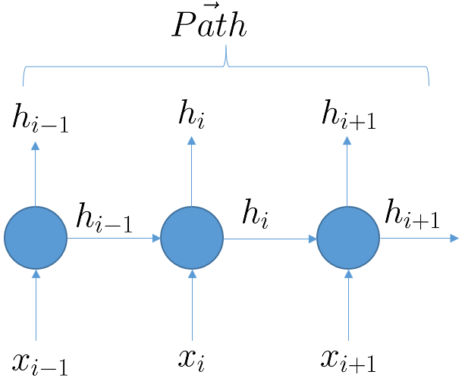
Conclusion
New block for handle trajectory (with LSTM)
Extend to multi-task learning by introducing an Auxiliary Component
Notes:
1. 之前的work想要加司机的话，受限于数据量不足等问题，但是我们得益于之前设计的通用block，轻易加入这样 的信息
强调一下，我们的重点在于：探索出来一种轨迹的表达方式，可以通过lstm来抽象轨迹，从而做到从整体上预测travel time，而不是单独一段，或者几段的拼接，
这个
预测结果准确度高
不依赖人工特征抽取
模型普适性强，扩展容易
可多机多卡并行高效处理海量数据 (MxNet/TensorFlow)

Slide 38
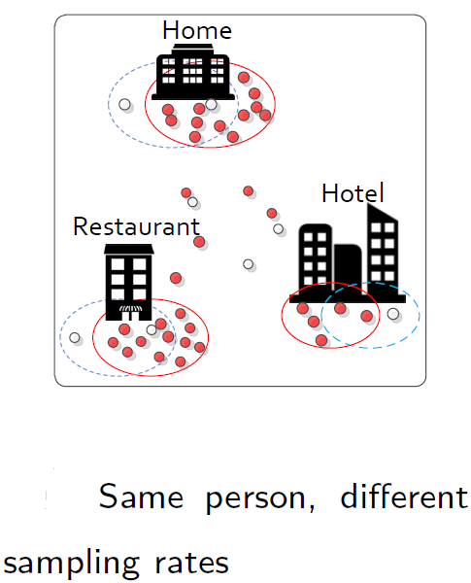
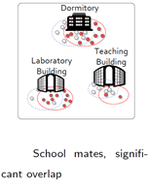
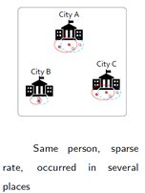
Automatic User Identification across Heterogeneous Data Sources
Goal: Identify the same user from the historical trajectory data set.
Motivation: human mobility, data integration, improve data quality
Challenges:
Very different sampling rates
Information loss in sparse trajectories
Temporally disjoint
Distinguish the overlaps
Same person,
different sampling rates
School mates, significant overlap
Same person, sparse rate, occurred in several places
ICDE 2016
Notes:
在这个work中，我们的目标是从历史轨迹中，找出哪些轨迹属于同一个人。研究这个问题的motivation一方面是对human mobility的理解，另一方面这个在我们应用中可以对不同数据源的轨迹数据做数据整合从而提高数据质量。首先我们说一下我们为什么能够做到基于轨迹数据就识别出来是不是同一个人。这个问题最开始发表在nature上，说明人们的mobility pattern是独立性非常强的，每个人有自己的一个特征比如一般几点出门，在哪里工作，中午喜欢去哪里吃饭等等。我们本质上是想衡量mobility pattern的相似性从而发现相同的用户。

Slide 39
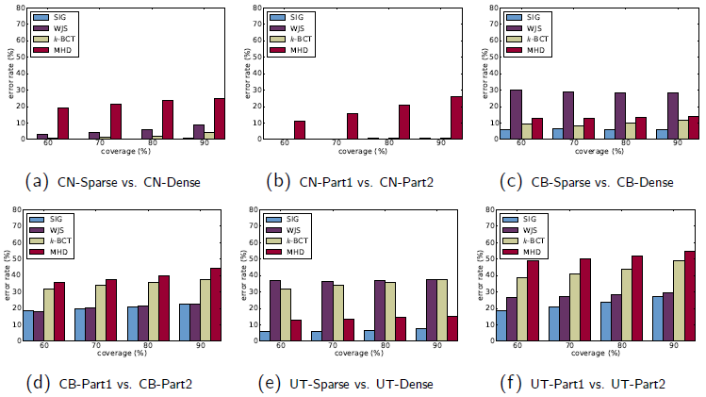
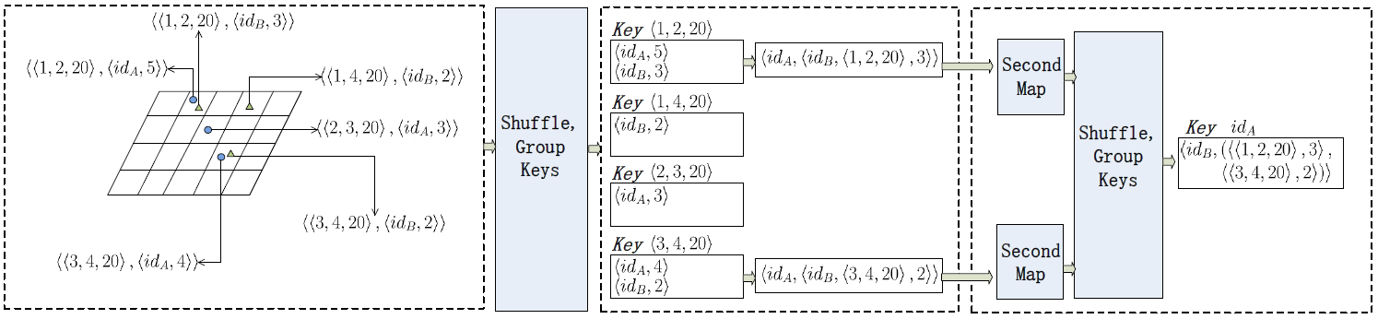
Automatic User Identification across Heterogeneous Data Sources
Novel similarity measure based on signals:
co-occurrence, sampling rate, distance
Robust performance
Efficient framework based on MapReduce
这里说明图片内
Notes:
1~2页说一下

Slide 40
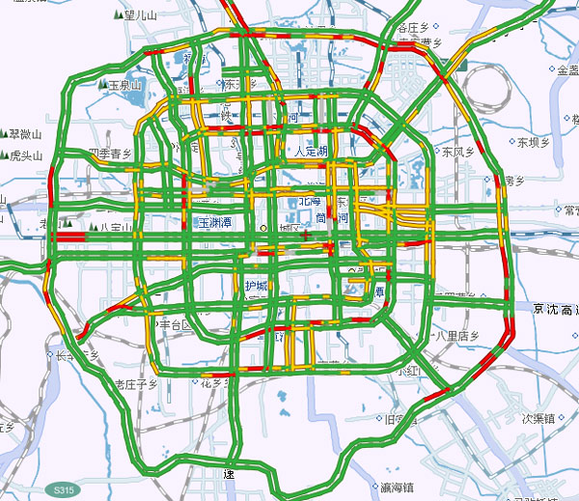
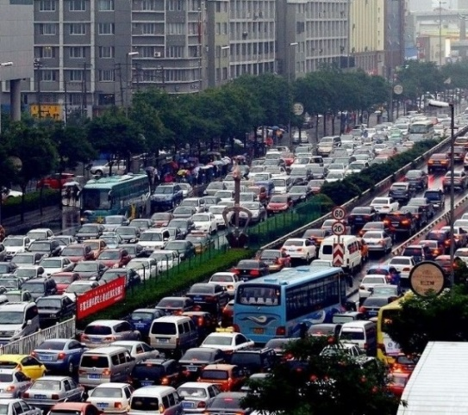
ETCPS: An Effective and Scalable Traffic Condition Prediction System
Goal: Predict the traffic condition of each road in the urban area after 15 minutes
Motivation: traffic management, routing service, taxi ride sharing
Previous work:
road side loop sensors data
GPS data collected from floating vehicles
only focused on the arterial roads
urban roads not considered
这里说明图片内
DASFAA 2017
Notes:
usually expensive, only highways and part of urban main roads
-- Large volume of GPS data.
-- from traffic condition time series.
-- Patterns vary significantly with time.

Slide 41
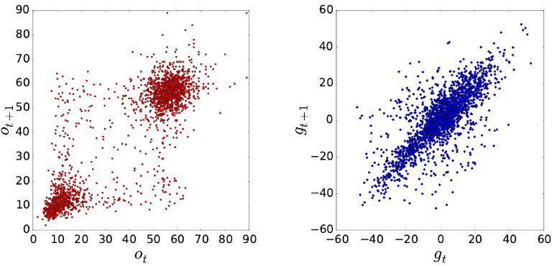
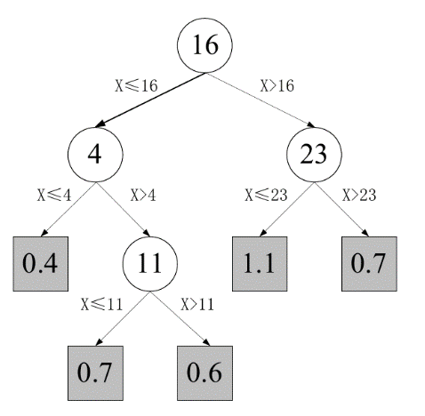
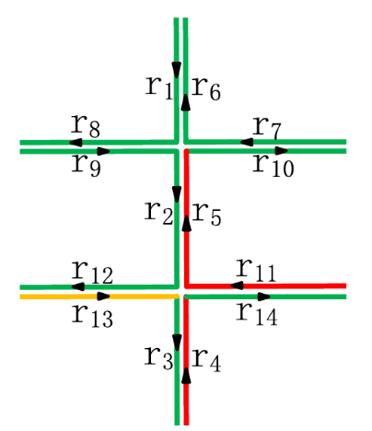
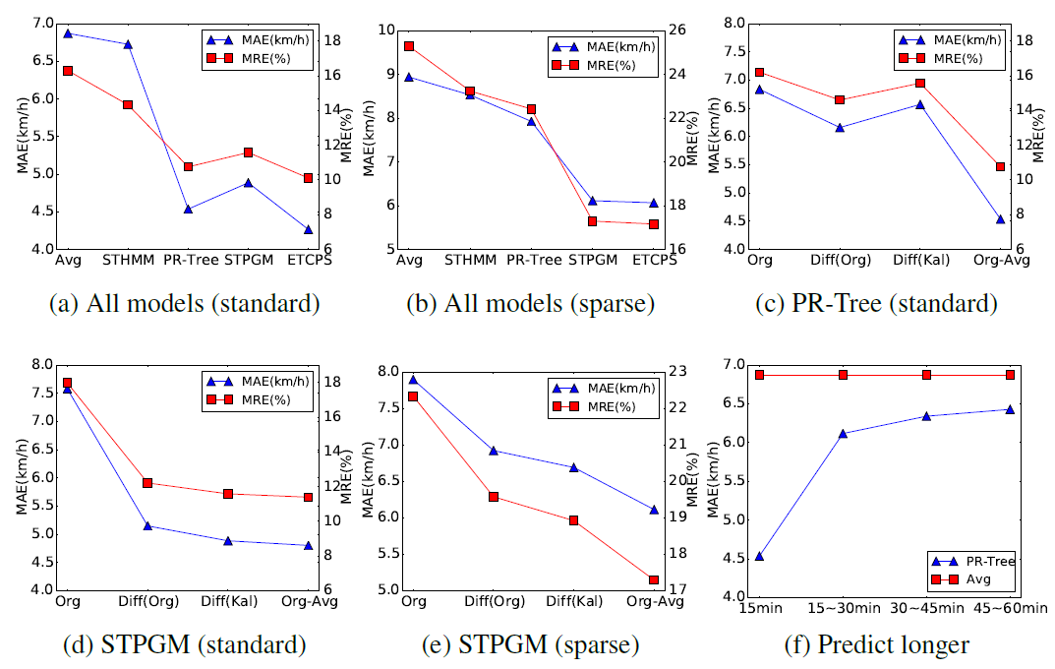
Traffic Condition Prediction System
Relationships observation
PR-Tree models the traffic condition time series of each individual roads
STPGM (Spatial temporal probabilistic graphic model) models the relationship between different roads
Our best quality prediction is achieved by a careful ensemble of the two models.
这里说明图片内
ICDE 2017
Notes:
实验稍微提一下
1、[可删] 通过观察发现一些规律
2、使用类似regression tree的模型model单条道路上的路况时间序列
3、使用STPGM来model相邻道路间的相关性
Stpgm类似于CHMM coupled hidden markov model，将每条道路的路况转换为不同的状态集，单条chain来model一条单独道路的路况状态转移时间序列，通过将不同adjacent的道路couple起来，使得相邻道路间的路况状态在转移过程中相互影响。
优点：1、观察到一些规律，显著提升了预测水平
2、分别考虑了单条道路自身内部时间上的关联，同时考虑了不同道路间的相关性
3、 比之前的work效果好，且速度快
缺点：1.model比较tedious，每条道路都要建一个自己的tree和graph，单独存了几万个model
2. 不同道路间的数据难共享，数据缺失稀疏等问题
3. 只能get到相邻道路间的关系，远一些的道路就不能了

Slide 42
On going work
Social Relationship Detection Based on Sequence to Sequence Learning
Goal:
Learn the similarity measure by neural network
Transform trajectories to vectors
Motivation:
Faster algorithm for similar user searching
Behavior prediction
Social relationship detection
Trajectory A
Trajectory B
LSTM
Encoder
LSTM
Encoder
这里说明图片内
Vector A
Vector B
Similarity Measure

Slide 43
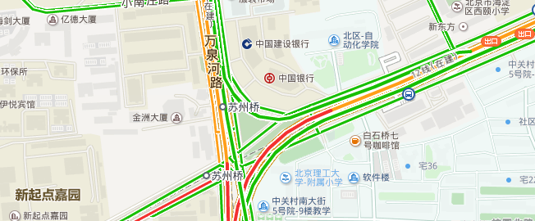
On going work
Characterizing Traffic Conditions using Recurrent Neural Networks
Goal: characterize the traffic condition of any given path in the last 30 min.
Motivation:
Enhance accuracy for travel time estimation
Refinement prediction of travel flow
Path
Traffic flow
Traffic Condition Network
Travel Time Estimation Network
Traffic condition vector
outdated estimation
Notes:
这个work里面我们目标是formalize一条路的路况。实际上我们很难定义清楚，给一条path，这条path的路况究竟是什么，这个是一个比较抽象的概念。他可能包括这一段的拥堵情况，平均速度，相邻路段拥堵情况等等。
我们的一个想法是，我们用神经网络来把"路况"抽象表示到一个高维向量中。具体做法是，
我们利用我们第二work遇到到达时间的网络结构，只利用前30分钟全城的轨迹数据，训练一个神经网络，并用这个网络对给定的path做预测。这个预测肯定是不准的，因为他只利用了最近30分钟的信息。但是我们把最后一层的隐藏层取出来，这个vector就可以当做前30分钟这段道路的路况。然后我们把这个vector传给我们的到达时间预测网络一起训练来提高训练精度（这个时候右面那个网络也在更新）。我们目前实验结果上来看，这个结果确实让我们的到达时间预测结果提升了，但我们得到的路况的vector究竟包含哪些信息我们还在进行实验分析。

Slide 44

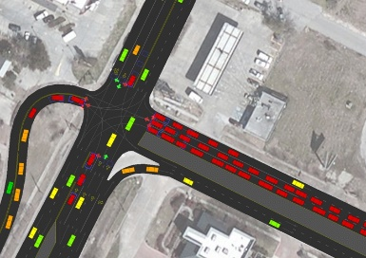


Future plan
Simulation of complicated environment using generative models
Spatio-temporal data generator under complicated environment
Provide information for decision making
这里说明图片内
Generative Adversary Nets
(e.g. Info Gan)
Notes:
下面我简单谈一下我们未来的一些research plan，我之前的工作都是用时空大数据来做分析和预测，在现实应用中，预测只是帮助我们来进行决策，比如根据供需进行网约车的调价，调度，根据仓储提货数据优化物品摆放位置等。现在一般的方法是将预测和决策进行分离。我们先进行预测，然后再进行决策。我们下一步想增强学习，将预测和决策这两个东西结合起来。深度增强学习也是现在的热点之一，比如大家可能都比较熟悉的alphaGo。我们之后希望用。。。将预测与决策结合起来

Slide 45



Future plan
Policy designing using the Deep Reinforcement Learning
Car-dispatching
Price adjusting
Storage planning
……
Deep Reinforcement Learning
Combine prediction & simulator & decision making
Deep learning to learn Q-function
Notes:
我们另一个计划就是时空数据的生成模型。比如说我们如何虚拟的生成订单数据，或者我们虚拟生成交通流量，或者虚拟市场交易数据。那么有了这个生成模型，我们才能说我们完全理解了这个模型。一方面生成模型能帮助我们理解，另一方面我们如果有了生成模型，我们就能够用它来模拟新的环境，来进行训练，就相当于是增多了我们的训练数据，也可以用来测试新的场景。现在已有的一些基于随机过程建模的模型，然而他们并不能学习实际问题中复杂的多因素影响和非线性特征。我们可能会用到一些基于深度学习的生成模型比如产生式对抗神经网络。这些模型同时训练一个产生器和一个判别器，产生器和判别器都是基于复杂的深度神经网络。产生器的目标是生成尽可能接近真实数据分布的数据，判别器的目标是尽可能区分生成数据和真实数据。这样经过充分训练直到两个模型达到纳什均衡，我们就能够很好的模拟复杂的真实环境。

Slide 46
Future plan
What if I were fortune enough …
Set up a deep learning course to attract more students
Build up a deep learning interest group
Research
Machine learning competitions
Apply the deep learning into economics
e.g., Spatial economics
Cooperation work with the Professors in economics

Slide 47
Thank you

